Slide 1



Internship Project Presentation On Forest fire detection using CNN
Intern Name : Patel Aksh Hemantkumar
Intern Id No: SMI61538
Project Domain: Data Science Internship
Batch : January 15, 2024 to April 15, 2024

Slide 2
Contents
Introduction
Requirements of Projects
Literature Survey
Comparative Analysis of Existing Works
Proposed Approach
Project Design (DFD, Use-Case) and Flow-chart
Implementation
Results
Conclusion and Future Plan

Slide 3
Introduction
Fire in the forest can occur naturally or by humans. Naturally, fire takes place due to extreme drought, hot weather, lightning or combustion of dry leaves and scobs. Human activities like throwing cigarettes, especially in forest areas or using borne fire also lead to fires.
So, fires which take place due to humans, are identified earlier than naturally occurring fires. There are various factors involved when a region catches fire. The hot and dry weather works as catalysts for fire. Since when there is fire in any region then the temperature of the region will become high due to fire. So increase in temperature is one of the factors which can help in fire detection events.
But we cannot just depend on temperature to detect fire as the temperature of a region also may increase due to sunlight. So we can also check the concentration of CO, CO2 gases in that region to detect the fire. But CO, CO2 gases can also be generated when someone uses the cigarette in that region so it may give false alarm, i.e., false fire event detection.
To increase the accuracy in predicting fire events, we will use various ML algorithms to check if there is fire or not. We will also train the machine and test by providing custom input whether there is fire or not. We will also calculate the accuracy, recall, and precision of these ML Algorithms. Hence we can save our environment ,animals and livelihood from the adverse results of forest fires.

Slide 4
Requirements of Project
HARDWARE:
Processor Above: 1.5Ghz
Hardware Disk: 80GB
RAM: 2GB
SOFTWARE:
OS: Windows 7,8, 10
Language: Python
IDE: Jupyter Notebook ,Google Colab (by Google)

Slide 5
Literature Survey
CNN has been proposed for the detecting the fire occurrence in different systems . The projected model uses advanced countenance transform and order calculations through deep education and the convolutional affecting animate nerve organs arrangements (CNN) which will boost the dwellings smoke alarm performance and eradicate annoyance alarm sketches.
The CNN based network has been proposed in paper , proposes use of transfer learning that is based on deep CNN approach to detect fire. It includes the use of MobileNet and pre-trained deep CNN architecture namely VGG, for development of fire detection system. These deep CNN models are trained on imbalanced datasets to impersonate optimal situations.

Slide 6
Comparative Analysis of Existing Works
S.No. | TITLE | AUTHOR | YEAR | DESCRIPTION | LIMITATION
1. 2. | A New Approach for Event Detection using k -means Clustering and Neural Networks Use of AI Techniques for Residential Fire Detection. | M. O. Oladimeji, M. G. Smiee and S. D. Mieee M Bahrepour, N. Meratnia & P.J.M Havinga | 2015 Conference Paper AIAI 2009 (Journal) | We study the event detection problem using convolutional neural networks (CNNs) that overcome the two fundamental limitations of the traditional feature-based approaches the complicated feature engineering for rich feature sets. Early residential fire detection is important for prompt extinguishing and reducing damages and life losses. To detect fire, one or a combination of data-sets algorithms and sensors needed. | Error propagation from the preceding stages which generate these features. Complicated feature engineering for rich feature sets.

Slide 7
Proposed Approach
Dataset is taken from UCI Machine Learning repository, description of dataset is described as below:
Dataset contains image and video data.
Image data contains test and train data in image format each having 3 class i.e., default, smoke, fire.
Test_default has 84 images, test_fire has 57 images, test_smoke has 30 images.
Train_default has 161 images, train_fire has 274 images, train_smoke has 258 images.
Video data contains test and train data in video format.
Test_video contains 3 videos.
Train_video contains 12 videos consisting of fire with smoke, only fire, only smoke, no fire videos.

Slide 8
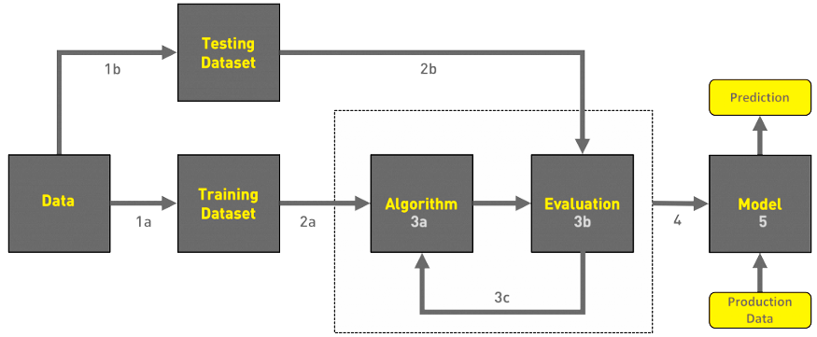
Project Design/Model
Gathering data
Data pre-processing
Researching the model that will be best for the type of data
Training and testing the model
Evaluation
Workflow of Project

Slide 9
Implementation Analysis
Algorithms
Accuracy
Decision Tree
Naive Bayes Classifier
Logistic Regression
Feed forward neural network
Support Vector Machine
Random Forest
CNN
Precision
Recall
Training & Testing

Slide 10
Results
For this purpose “Forest-fires.csv” dataset from UCI machine learning repository was taken and machine learning algorithms were applied to find accuracy of detection. The dataset “Forest-fires.csv” contains 517 instances and 13 attributes.
Machine Learning Algorithm | Accuracy
Decision Tree | 52.56%
Naive Bayes Classifier | 48.07%
Logistic Regression | 55.80%
Support Vector Machine | 68.72%
Convolutional Neural Network | 72.33%

Slide 11
Conclusion
In the case of forest fire detection ML algorithms remove the difficulty faced in traditional methods like man standing on a tower and monitoring the environment.
All the data in the dataset has to be aggregated to reach the result so it is done by using tree based and cluster based methods.
With the use of machine learning techniques, the problem of faulty nodes is minimized. With the use of regression algorithm network lifetime is enhanced and with the use of decision tree algorithm network lifetime is enhanced as well as accuracy. SVM and Convolutional neural network (CNN) gives better results.

Slide 12
Future Plan
We will be finding a method based on machine learning which will be,
Accurate in prediction
Fault Tolerant
Robust
And then finding its space and time complexity and will try to optimize it.
GitHub Repository Link: https://github.com/OfficialAkshPatel/Forest-Fire-Detection-using-CNN.git

Slide 13
Thank You !

